Slide 1
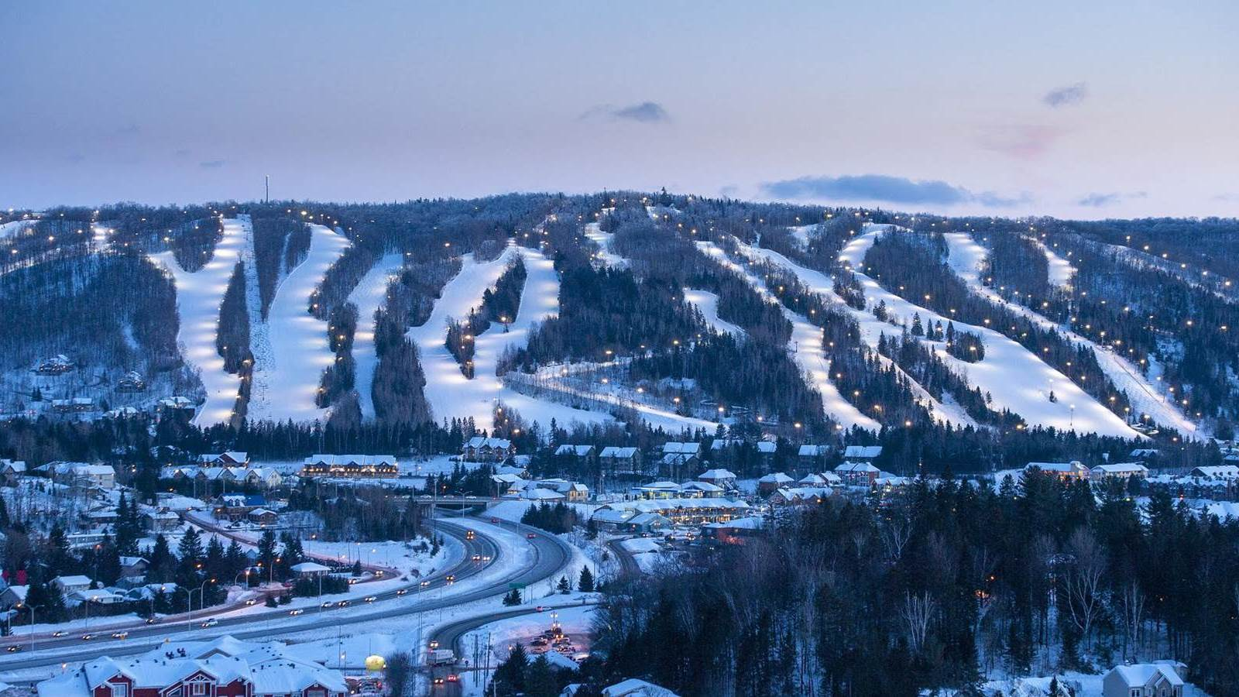
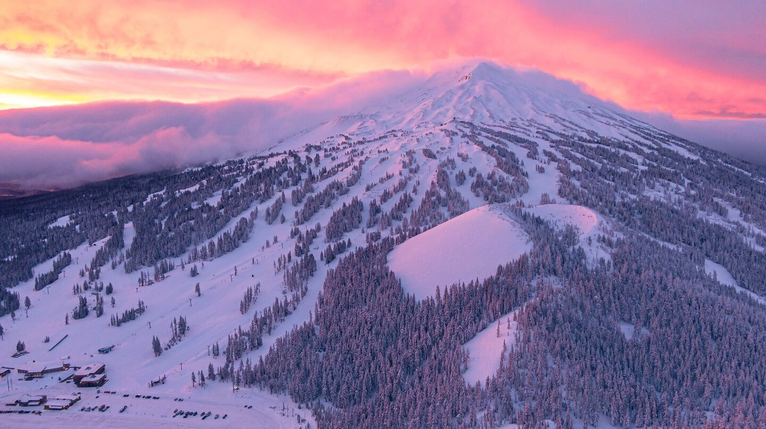

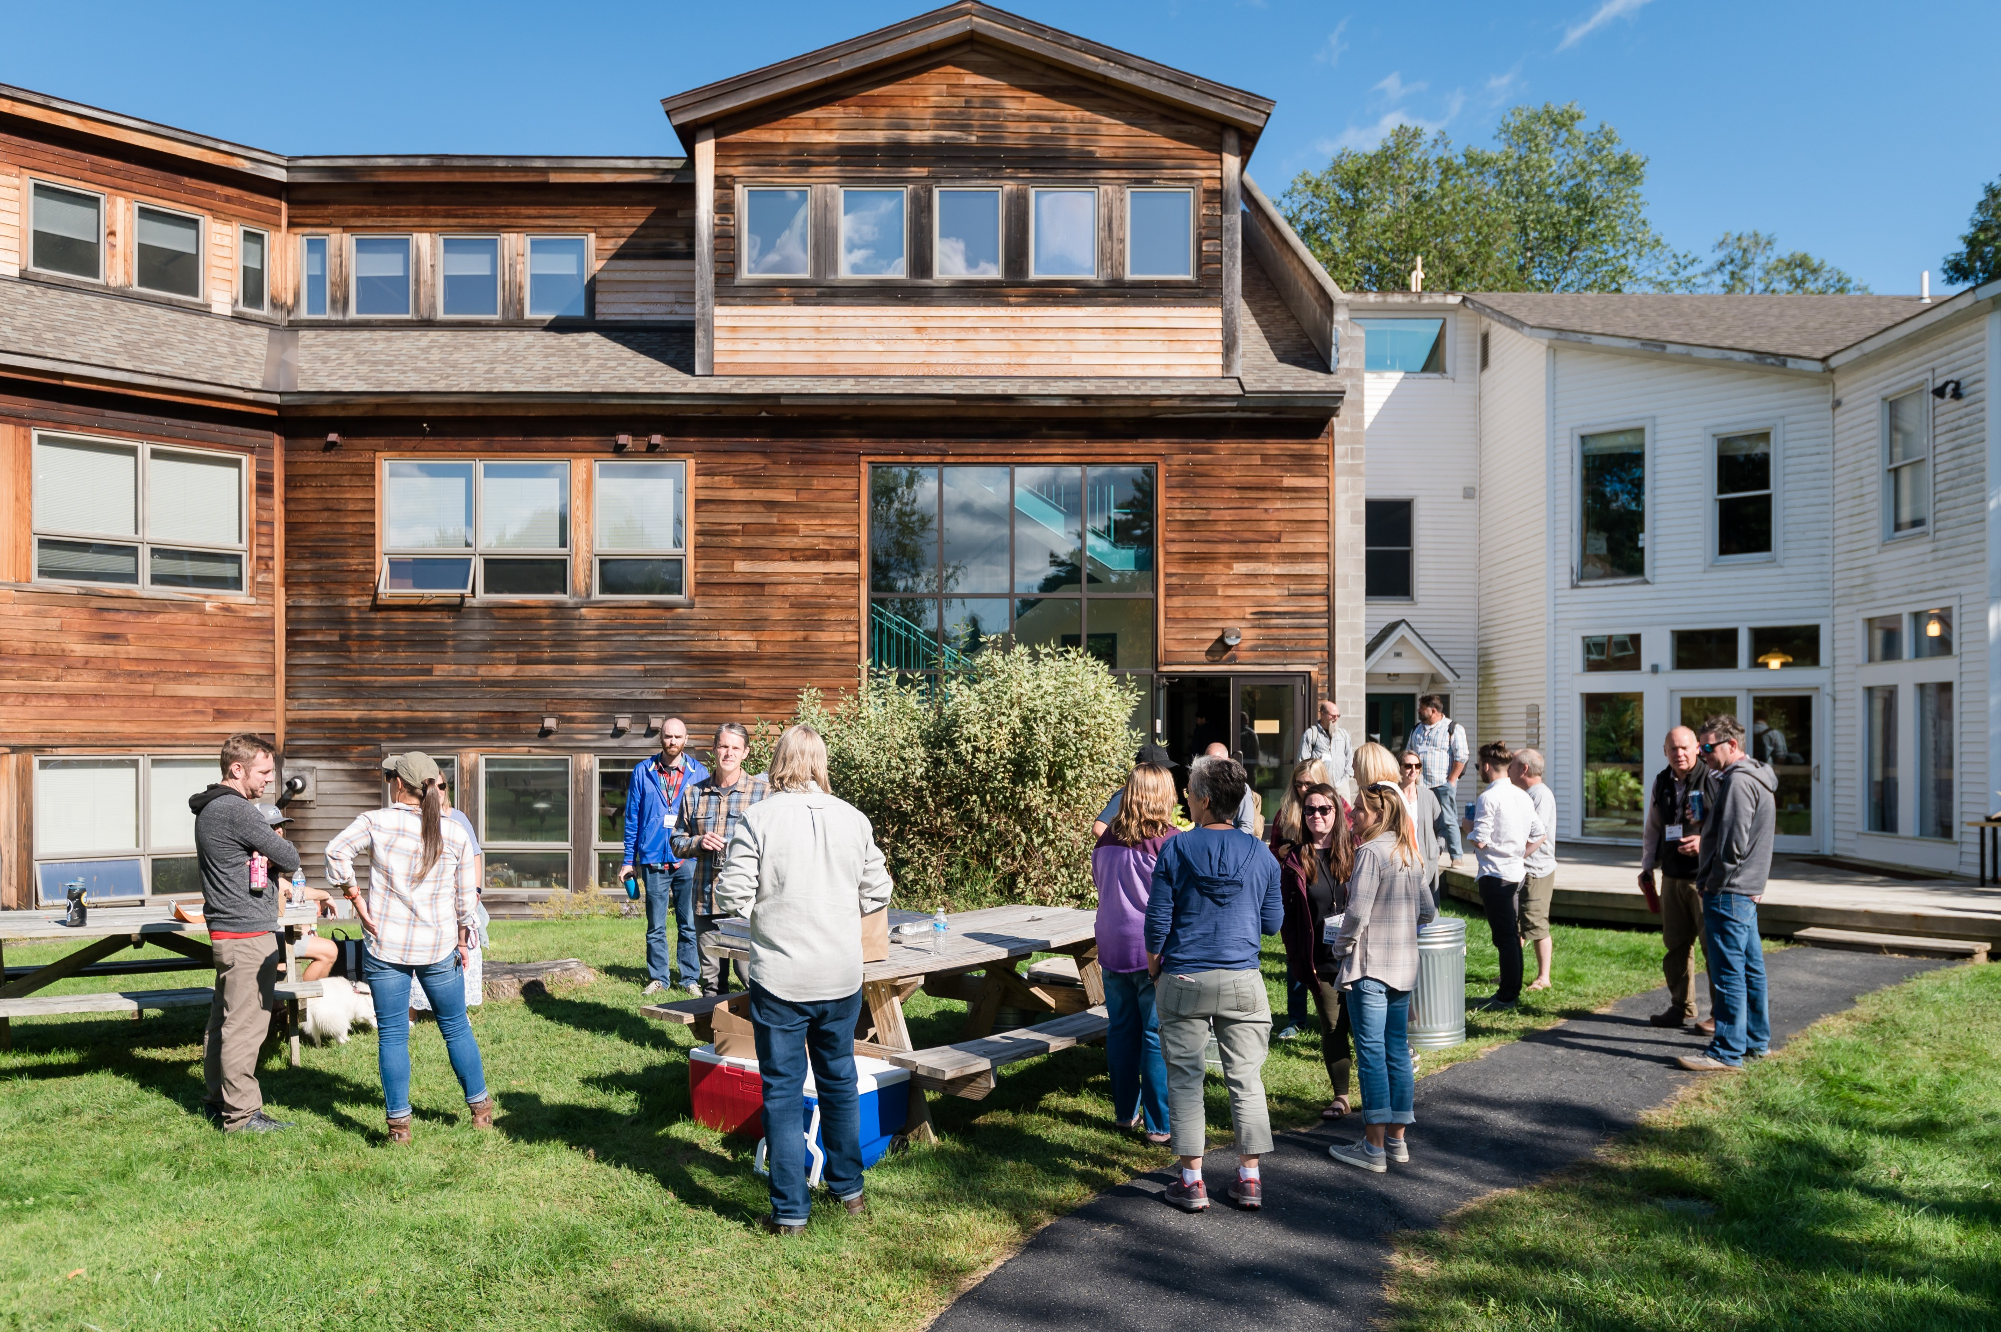

Pretitle
Name of Deck or Meeting
January 2025

Slide 2
Pretitle
Name of Deck or Meeting
January 2025

Slide 3
Projects in Motion
Projects in Motion
Inntopia Items
Resort Items
Placeholder
Placeholder

Slide 4
Email Performance
December 2025
Analysis and insight goes here.

Slide 5
Total Campaigns
Email Performance
December 2025
36
Analysis and insight goes here.
Commmentary and additional detail would go here.
Total Campaigns
36
Commmentary and additional detail would go here.

Slide 6
Email Performance
Total Campaigns
December 2025
36
Analysis and insight goes here.
Total Campaigns
36
Total Campaigns
36

Slide 7

Subtitle
You can swap the background image.

Slide 8
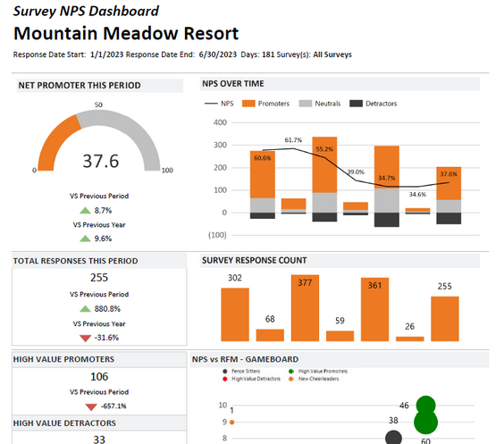
News, Tips, and Trends
Happy New Year!
With the first big holiday period behind us, there are only 3 more key holiday periods this winter.
How did the holidays go? Where did you find success and what challenges did the resort face? What are the opportunities?
Review Post Departure Survey Results from the holiday period or consider adding one to your toolbox.
Remove hurdles to make season pass renewal an easy decision for your 24/25 season passholders.

Slide 9
News, Tips, and Trends
Happy New Year!
With the first big holiday period behind us, there are only 3 more key holiday periods this winter.
How did the holidays go? Where did you find success and what challenges did the resort face? What are the opportunities?
Review Post Departure Survey Results from the holiday period or consider adding one to your toolbox.
Remove hurdles to make season pass renewal an easy decision for your 24/25 season passholders.

Slide 10
News, Tips, and Trends
Last-Minute Checklist
Use this checklist to minimize any opening-day hiccups:
Surveys: Ready to go? Make sure your survey is winter-specific. Working with Guest Research? Be sure to review triggers and set a start date.
Snow Reports: Test and make sure your report is ready to go for opening day.
Welcome Letters: Review to make sure letters are updated for winter.
Pre-Arrivals: Review content and triggers. Make sure they are specific to winter.
Automation Reviews: Double-check that your automations are up-to-date. Consider a weekly Email Statistics Summary (or Automated Email Campaign Dash) to ensure your automated messages are being sent.

Slide 11
News, Tips, and Trends
Last-Minute Checklist
Use this checklist to minimize any opening-day hiccups:
Surveys: Ready to go? Make sure your survey is winter-specific. Working with Guest Research? Be sure to review triggers and set a start date.
Snow Reports: Test and make sure your report is ready to go for opening day.
Welcome Letters: Review to make sure letters are updated for winter.
Pre-Arrivals: Review content and triggers. Make sure they are specific to winter.
Automation Reviews: Double-check that your automations are up-to-date. Consider a weekly Email Statistics Summary (or Automated Email Campaign Dash) to ensure your automated messages are being sent.

Slide 12


News, Tips, and Trends
Five Ways to Improve Your Deliverability in 2025
Becoming a champion of email deliverability is more straightforward than you may think
As you move into winter 2024/25, we’ve compiled five easy tips to help you get a jump start. Prevention is much easier than recovery!
Read This Article →

Slide 13
News, Tips, and Trends
Five Ways to Improve Your Deliverability in 2025
Becoming a champion of email deliverability is more straightforward than you may think
As you move into winter 2024/25, we’ve compiled five easy tips to help you get a jump start. Prevention is much easier than recovery!
Read This Article →

Slide 14
News, Tips, and Trends
DestiMetrics Webinar | Destination Travel Outlook
Thursday, January 16th 12:00 PM MST
Tom Foley, Inntopia's SVP of Business Intelligence will highlight data trends, how they are relevant to destination travel, and why you should pay attention to them. He will provide a recap on our full Winter 2024/25 with our December 31st data. He will use the remaining time to provide a deeper analysis on these trends and open it up for discussion and insights from Inntopia Partners. If you'd like to tee up a question or discussion topic ahead of time, after you register, you'll be redirected to a page where you can enter these anonymously.
Register Here →

Slide 15

Register Here →

