Slide 1

Inntopia Something
The title of a more generic sorta presentation.
Some sub text goes here, maybe a date?

Slide 2

Inntopia Something
The title of a more generic sorta presentation.
Some sub text goes here, maybe a date?

Slide 3

Inntopia Commerce
The title of a Commerce-related presentation.
Some sub text goes here, maybe a date?

Slide 4

Inntopia Marketing Cloud
The title of a Marketing Cloud-related presentation.
Some sub text goes here, maybe a date?

Slide 5

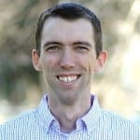
Insight365
Amazing New Commerce Systems Built on the Inntopia API
Gregg Blanchard
SVP Marketing, Inntopia
Inntopia
#Insight365

Slide 6
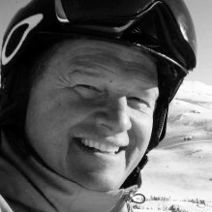
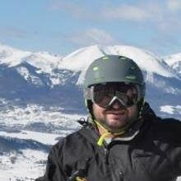
Insight365
Lessons Learned from Pandemic-Driven Cancellation Policies
Erik Austin
VP of Reservations, Vail Resorts
Alex Hinkel
Director of Reservations, Vail Resorts
Inntopia
#Insight365

