Slide 1
Inntopia INSIGHT Conference

Slide 2


Agenda
SMS Overview
2017 Projects
Current Integration Technology
Potential Integration Technology
Q & A

Slide 3

1984
Founded in
64
Countries
Served
1000+
Luxury 4 & 5 Star
Hotels, Resorts & Spas
20+
Integrated
Modules
SUPPORT
4
International Offices

Slide 4
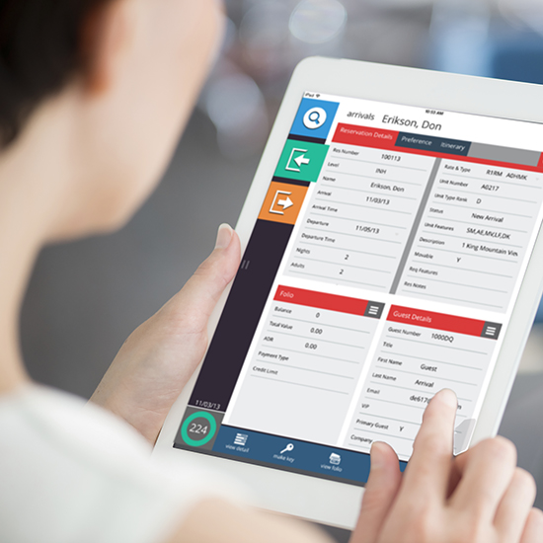
2017. Major Projects Underway at SMS
Guest Experience. ^{SMS}|Host Anywhere
Revenue. ^{SMS}|Host Derived Rate Functionality
System. Hosting & SQL Database Capabilities
Security. V21, fully out-of-scope from a PCI perspective

Slide 5
















Current Integration
Availability
Rates
Inventory
Restrictions
Reservations
  New, Modifications, Cancelations
  Notes
Deposit Posting

Slide 6
Future Integration Potential
Availability requests & Reservation delivery to SMS Golf Tee Times
Availability requests & Reservation delivery to SpaSoft Spa Management
SMS|Host Group Block handling
SMS|Host Owner Fulfillment Portal integration
SMS|Host Bi-Directional Reservation Synchronization

Slide 7
Q & A

