Slide 1
Blanchard Golf Resort Stay & Play Platform Demo
DECEMBER 25, 2016

Slide 2
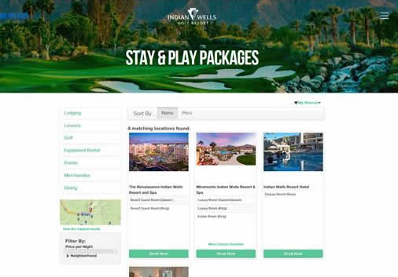
Stay & Play
Choose dates
Select room
Add tee-time
Add anything else
Check out

Slide 3

"There is no better CRM vendor in the industry and they truly understand our business." Christian Knapp, Aspen Snowmass VP Marketing

